Slide 1
Chapter 28
Halliday & Resnick’s
Fundamentals of Physics
By Jearl Walker
Magnetic Fields

Slide 2
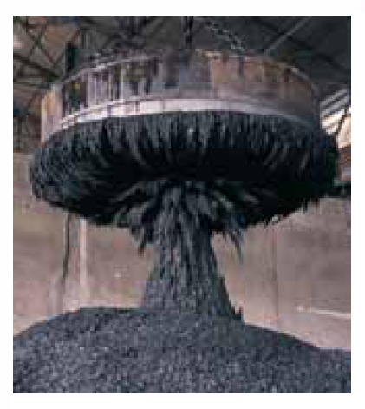
28.2: What Produces Magnetic Field?:
One way that magnetic fields are produced is to use moving electrically charged particles, such as a current in a wire, to make an electromagnet. The current produces a magnetic field that is utilizable.
The other way to produce a magnetic field is by means of elementary particles such as electrons, because these particles have an intrinsic magnetic field around them.
The magnetic fields of the electrons in certain materials add together to give a net magnetic field around the material. Such addition is the
reason why a permanent magnet, has a permanent magnetic field.
In other materials, the magnetic fields of the electrons cancel out, giving no net magnetic field surrounding the material.

Slide 3
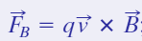
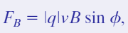
28.3: The Definition of B:
We can define a magnetic field, B, by firing a charged particle through the point at which is to be defined, using various directions and speeds for the particle and determining the force that acts on the particle at that point.
The magnetic force on the charged particle, F_{B}, is defined to be:
Here q is the charge of the particle, v is its velocity, and B the magnetic field in the region. The magnitude of this force is then:
Here φ is the angle between vectors v and B.

Slide 4
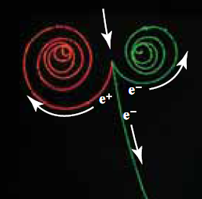
Fig. 28-3 The tracks of two electrons and a positron in a bubble chamber that is immersed in a uniform magnetic field that is directed out of the plane of the page.
(Lawrence Berkeley Laboratory/Photo Researchers)

Slide 5
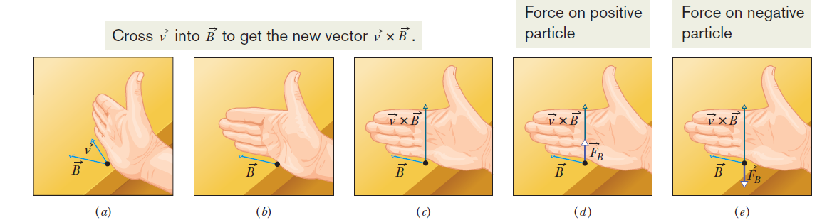
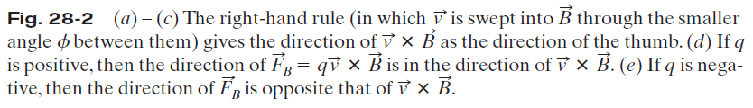
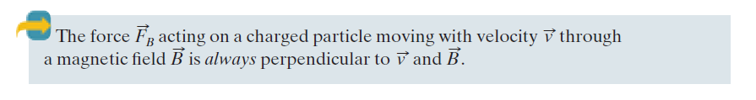
28.3: Finding the Magnetic Force on a Particle:

Slide 6
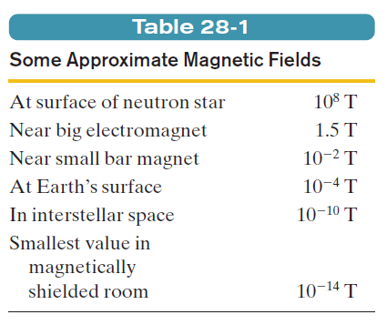
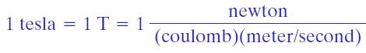
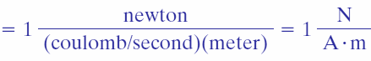

28.3: The Definition of B:
The SI unit for B that follows is newton per coulomb-meter per second. For convenience, this is called the tesla (T):
An earlier (non-SI) unit for B is the gauss (G), and

Slide 7
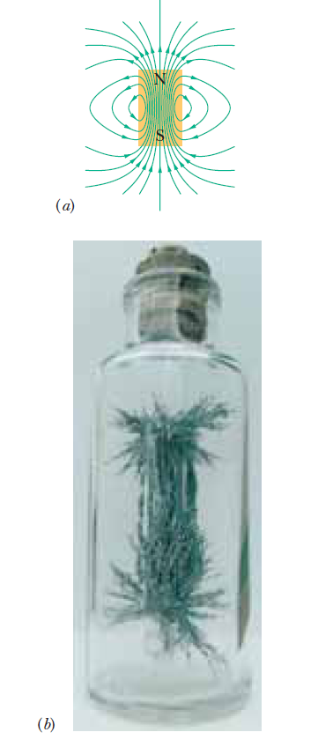
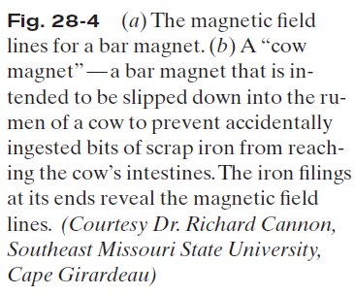
28.3: Magnetic Field Lines:
The direction of the tangent to a magnetic field line at any point gives the direction of B at that point.
The spacing of the lines represents the magnitude of B —the magnetic field is stronger where the lines are closer together, and conversely.

Slide 8
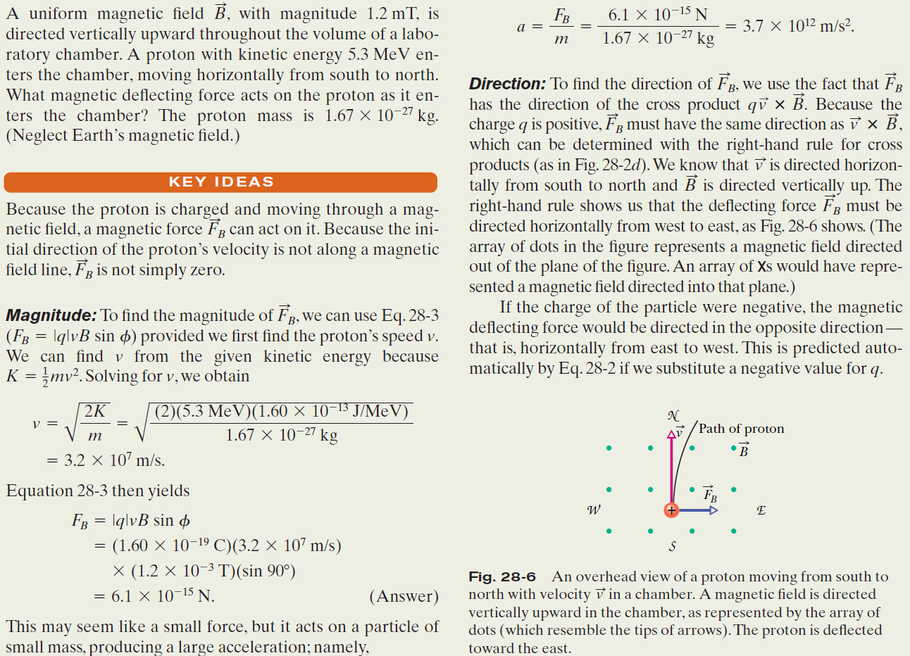
Example, Magnetic Force on a Moving Charged Particle :

Slide 9
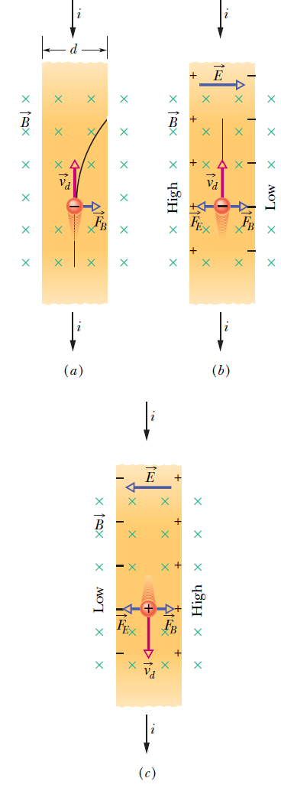
28.5: Crossed Fields, The Hall Effect:
Fig. 28-8 A strip of copper carrying a current i is immersed in a magnetic field .
(a)The situation immediately after the magnetic field is turned on. The curved path that will then be taken by an electron is shown.
(b) The situation at equilibrium, which quickly follows. Note that negative charges pile up on the right side of the strip, leaving uncompensated positive charges on the left. Thus, the left side is at a higher potential than the right side.
(c) For the same current direction, if the charge carriers were positively charged, they would pile up on the right side, and the right side would be at the higher potential.

Slide 10
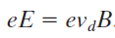
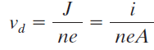
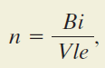
A Hall potential difference V is associated with the electric field across strip
width d, and the magnitude of that potential difference is V =Ed.
When the electric and magnetic forces are in balance (Fig. 28-8b),
where v_{d} is the drift speed. But,
Where J is the current density, A the cross-sectional area, e the electronic charge, and n the number of charges per unit volume.
Therefore,
Here, l=( A/d), the thickness of the strip.

Slide 11
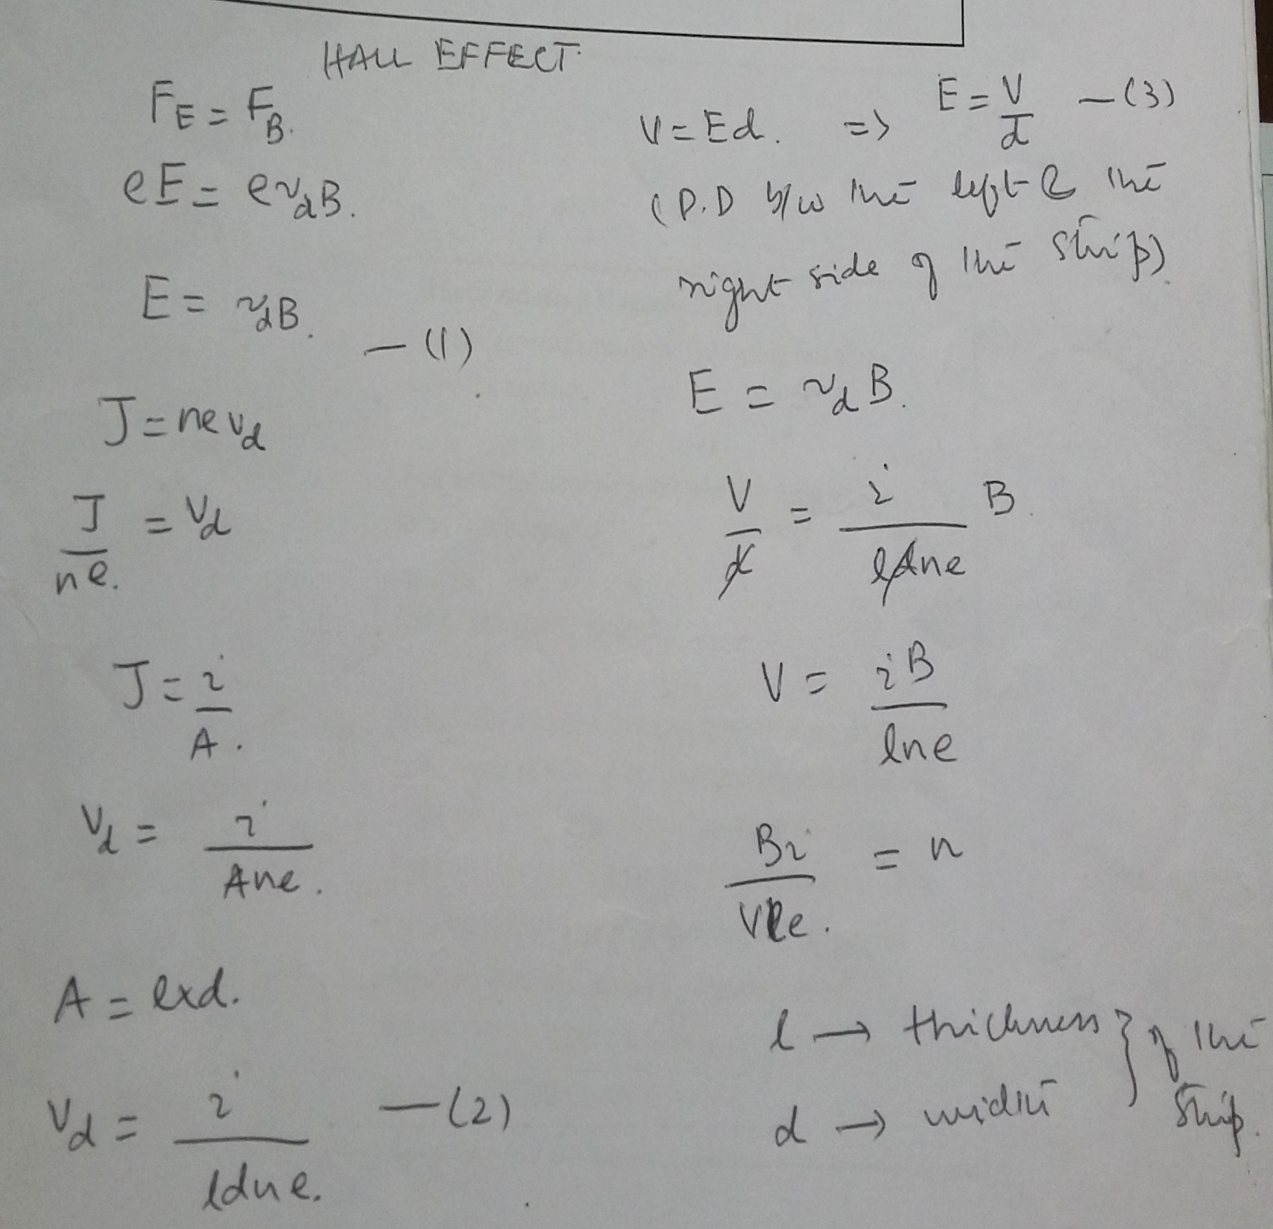

Slide 12
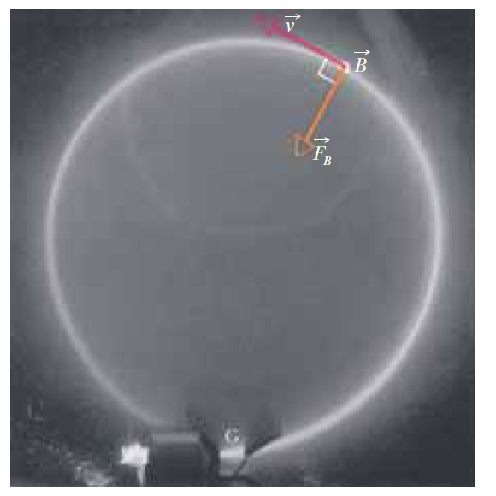
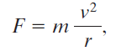
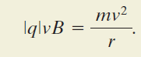
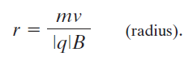
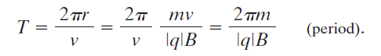
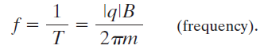
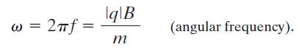
28.6: A Circulating Charged Particle:
Consider a particle of charge magnitude |q| and mass m moving perpendicular to a uniform magnetic field B, at speed v.
The magnetic force continuously deflects the particle, and since B and v are always perpendicular to each other, this deflection causes the particle to follow a circular path.
The magnetic force acting on the particle has a magnitude of |q|vB.
For uniform circular motion
Fig. 28-10 Electrons circulating in a chamber containing gas at low pressure (their path is the glowing circle).
A uniform magnetic field, B, pointing directly out of the plane of the page, fills the chamber.
Note the radially directed magnetic force F_{B} ; for circular motion to occur, F_{B} must point toward the center of the circle,
(Courtesy John Le P.Webb, Sussex University, England)

Slide 13
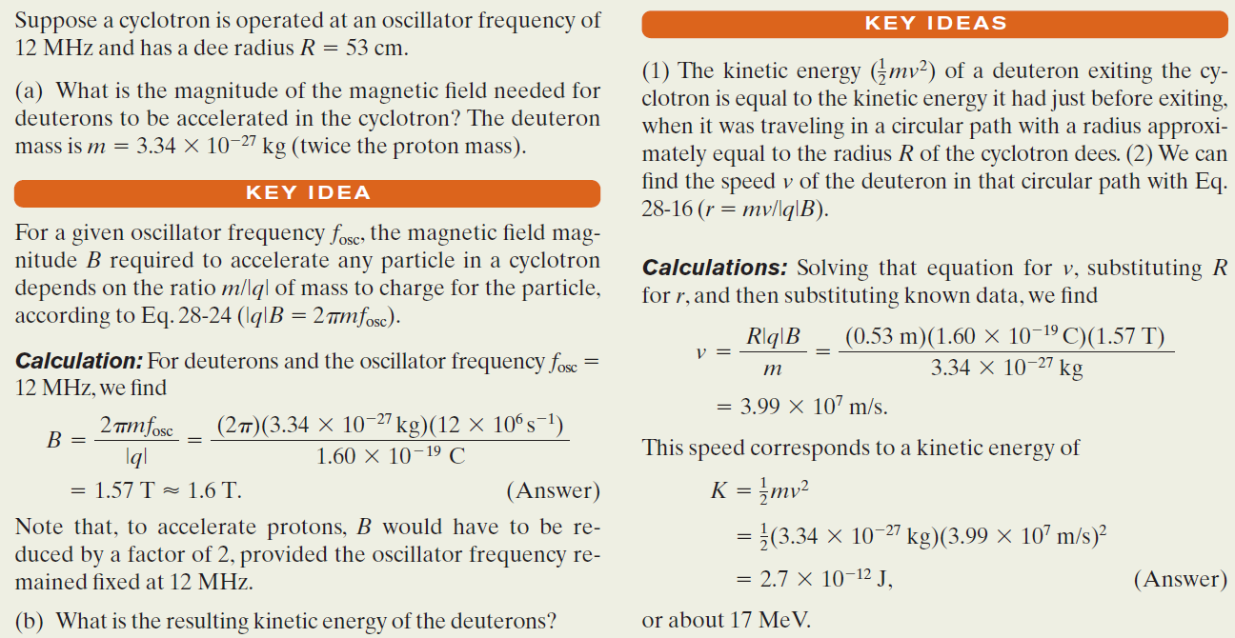
Example, Accelerating a Charged Particle in a Synchrotron:

Slide 14
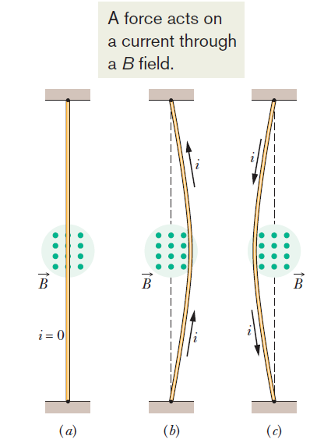
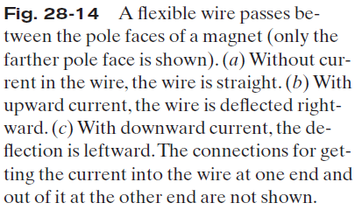
28.8: Magnetic Force on a
Current-Carrying Wire:

Slide 15
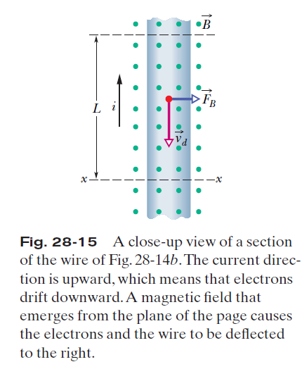
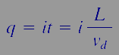
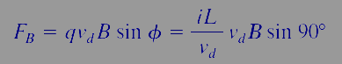
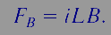
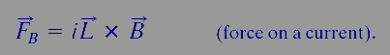
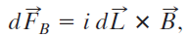
28.8: Magnetic Force on a
Current-Carrying Wire:
Consider a length L of the wire in the figure. All the conduction electrons in this section of wire will drift past plane xx in a time t =L/vd.
Thus, in that time a charge will pass through that plane that is given by
Here L is a length vector that has magnitude L and is directed along the wire segment in the direction of the (conventional) current.

Slide 16
If a wire is not straight or the field is not uniform, we can imagine the wire broken up into small straight segments . The force on the wire as a whole is then the vector sum of all the forces on the segments that make it up.
In the differential limit, we can write and we can find the resultant force on any given arrangement of currents by integrating Eq. 28-28 over that arrangement.

Slide 17
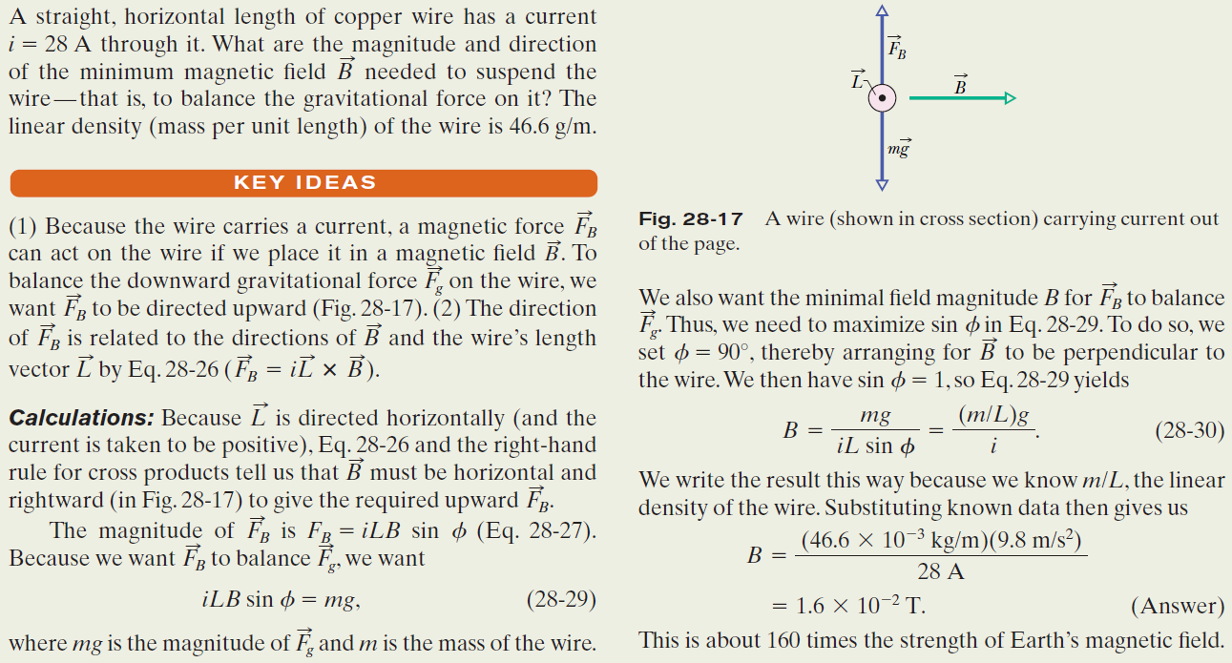
Example, Magnetic Force on a Wire Carrying Current:

